Slide 1

Chest Symmetry & Chest Expansion
By: Vaibhavi Wategaonkar
Final Year.

Slide 2
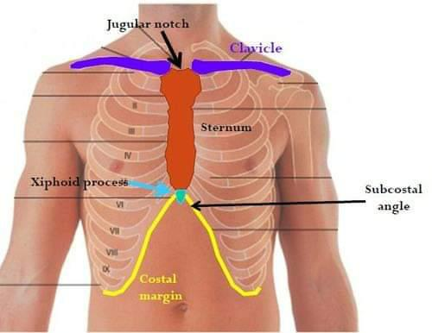
What is Normal Chest Symmetry ?
Normal chest symmetry- Bilaterally symmetrical, elliptical in cross section, transverse diameter is greater than antero-posterior diameter. The normal subcostal angle is about 70⁰ – the angle being more acute in males than in females.
The normal antero-posterior to transverse diameter ratio is 5:7 (HUTCHINSON’S INDEX).

Slide 3
What is Abnormal chest symmetry?
The Condition where size and shape of the chest gets altered in different diseased condition is known as abnormal chest symmetry.
Eg . (1)Pigeon chest in rickets ,
(2)Barrel chest in COPD (Emphysema)

Slide 4
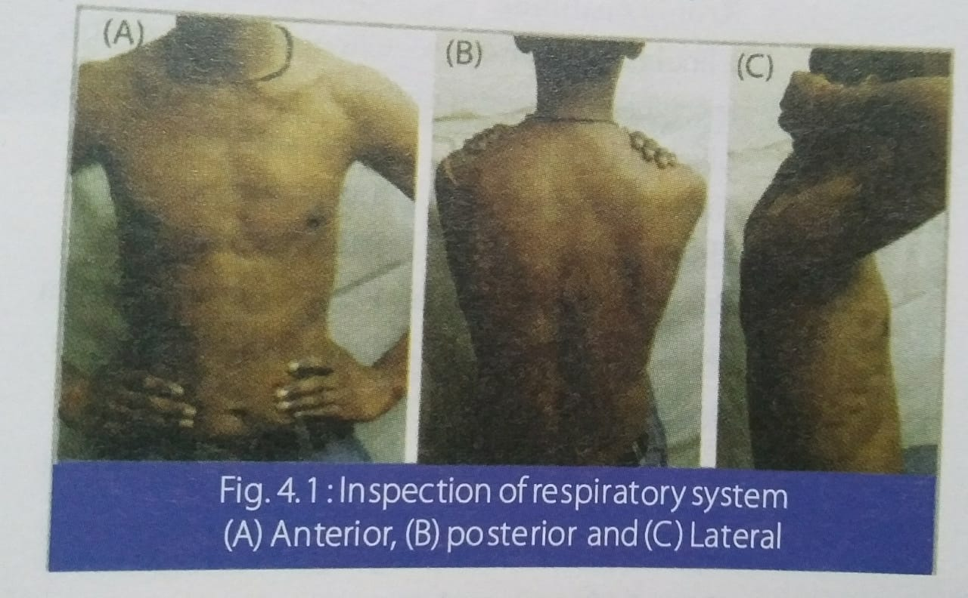
EXAMINATION.
ON INSPECTION:
1)SIZE AND SHAPE –
CAN BE SYMMETRICAL OR ASYMMETRICAL.
Anterior , posterior , lateral view
2)EXPANSION OF CHEST –
Ask the subject to take deep inspiration and deep expiration.
3)ACCESSORY MUSCLES OF RESPIRATION –
Working / not working

Slide 5
On Palpation.
1. Size and shape – symmetrical or asymmetrical.
Anterior-posterior diameter- Measure by using two cardboards.
Transverse diameter- Measure at level of nipple where we get maximum expansion by using two cardboards.
Circumference – By using measuring tape.
a). At the end of deep inspiration.
b). At the end of deep expiration.

Slide 6
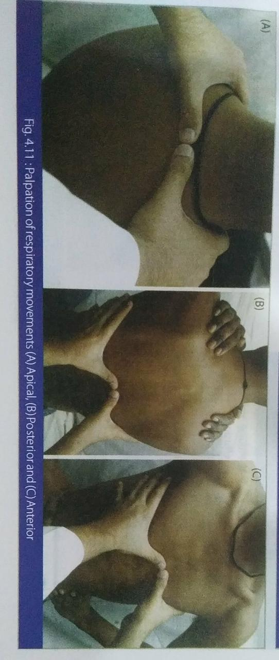
2. Expansion of chest :
Equal/unequal on both sides

Slide 7
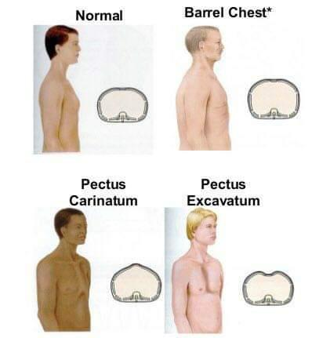
Deformities Of Chest.
PIGEON CHEST OR PECTUS CARINATUM.
There is depression on either side of the sternum often associated with bead like enlargement at the Costochondral junction and transverse groove passing outwards from the Xiphisternum to the mid-Axillary line .
Sometimes the sternum in unduly prominent and the cross section is triangular.

Slide 8
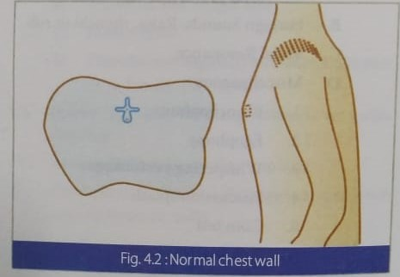
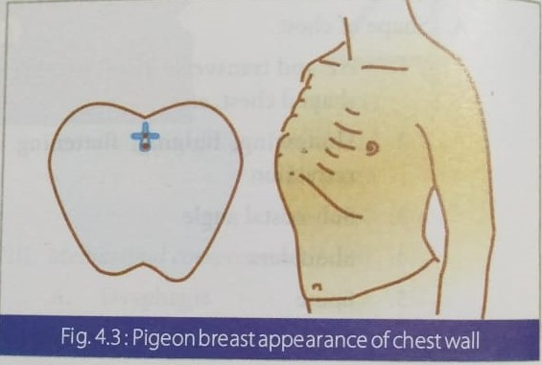

Slide 9
2. FUNNEL CHEST OR PECTUS EXCAVATUM.
There is a depression in the lower part of the sternum which may be congenital, following rickets in childhood or an occupational deformity in cobblers.
Due to sternal depression, the normal cardiac shadow may appear enlarged on X-ray chest.

Slide 10
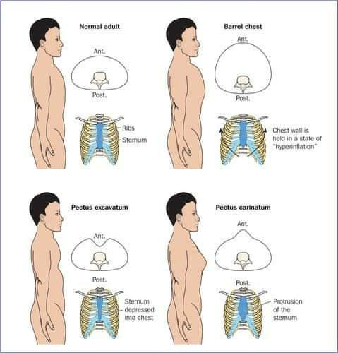
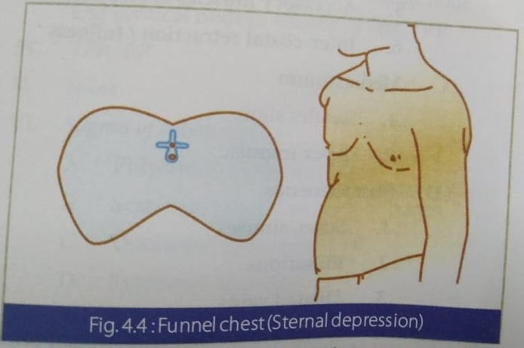

Slide 11
3. BARREL - SHAPED CHEST.
The antero-posterior diameter is increased ,the sub-costal
angle is wide, the angle of Louis unduly prominent, the sternum is more arched, the spine is concave forward and ribs are less oblique.
This is seen in emphysema , old age and infancy.
The normal ratio between AP diameter to transverse is 5:7 . In barrel chest it is 1:1 or more.

Slide 12
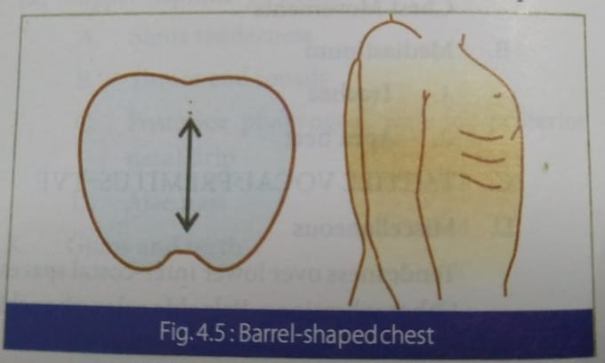
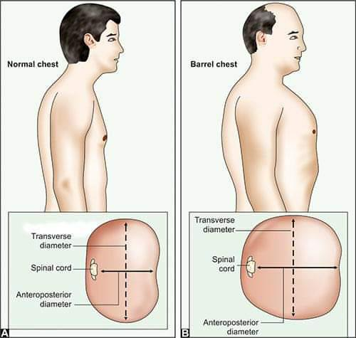

Slide 13
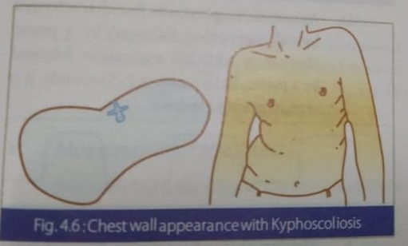
4. SPINAL DEFORMITIES.
Kyphosis or scoliosis due to any cause may lead to asymmetry and may decrease the size of the thoracic cage and restrict the lung movements and volume.

Slide 14
5. BULGING.
One side may bulge in pleural effusion , pneumothorax, tumors , empyema, cardiomegaly or scoliosis.
Localised bulging is seen in aortic aneurysm, pericardial effusion , liver abcess , chest wall tumor’s etc.

Slide 15
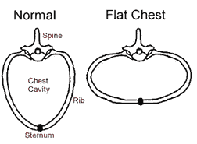
6.FLAT CHEST ( Phthinoid Chest).
The antero-posterior diameter is reduced in chronic nasal obstruction due to adenoid lymphoid hypertrophy, bilateral TB or childhood rickets.
In advanced TB, the scapula is winged and is called as Alar chest.
AP : Transverse diameter ratio is 1:2 or less.

Slide 16
Thank you!!

