Slide 1
ULTRASOUND
THERAPY
Dr. Pragati Patil MPTh (Neuroscience)
Assistant Professor
KCPT

Slide 2
Objectives
Introduction
parameteres
Physiological effets
Indications
Coupling Media

Slide 3
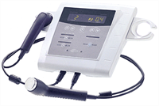

Slide 4
Introduction
Sound is defined as the periodic mechanical disturbance of an elastic medium such as air.
Sound requires a medium for its transmission and cannot cross a vacuum.
Ultrasound refers to mechanical vibrations, which are essentially the same as sound waves but of a higher frequency.
Such waves are beyond the range of human hearing and can therefore be called ultrasonic.

Slide 5
Parameters used in ultrasound
Wavelength: Distance between 2 closest points on a wave that are performing same motion at any instant in time.
Frequency: No. of times a particle undergoes a complete cycle in 1 sec.
Velocity: speed at which wave moves through the medium. Varies depending upon physical nature of medium.

Slide 6
Audible sound – 20 to 20000 Hz
Ultrasound – Greater then 20000 Hz(20 kHz)
Infrasound – Less than 20 Hz
Therapeutic ultrasound – 0.5 to 5 MHz – 1 to 3 MHz.

Slide 7
Properties of waves
Sonic waves are series of mechanical compressions and rarefactions in the direction of travel of the wave, hence they are called longitudinal waves.
They can occur in solids, liquids, and gases and are due to regular compression and separation of molecules.

Slide 8


Slide 9
It is energy that travels and not the matter.
As sound waves pass through any material their energy is dissipated or attenuated.
All the energy is absorbed at once; sound wave passes with almost no loss.

Slide 10
Sound waves will pass more rapidly through material in which the molecules are close together, thus their velocity is higher in solids and liquids than in gases.
The velocities of sound in some media are:
Air- 344 m/s.
Water- 1410 m/s.
Muscle- 1540 m/s.
Bone- 3500 m/s.

Slide 11
ULTRASOUND
In ultrasound therapy, ultrasound energy is used to treat tissues. This energy is applied through a transducer head which consist of crystal that vibrates to produce energy.
The upper limit of hearing is 20kHz. Ultrasound is well above this, therapeutic frequencies being in the region of 1 MHz or 3 MHz.

Slide 12
Production
For 1 MHz machine a vibrating source with a frequency of 1 million cycles /sec. is needed.
This is achieved using either a Quartz or a Barium titanate crystal. These crystals deform when subjected to a varying potential difference– a piezo-electric effect.
Reverse piezo-electric effect: Production of mechanical waves or vibrations due to the application of e.m.f.

Slide 13
Components of ultrasonic instrument
Main supply: A.C., normally of 220 volts having freq. of 50 Hz.
Transformers: step-up transformer is used.
Rectifier: current is converted from A.C. to D.C. flows to amplifier.
Oscillatro: high freq. oscillating current to the output circuit which then flows to amplifier.
Amplifier: purpose of increasing the magnitude of current is called amplification.
Co-axial cable: simple wire covered by a metallic plate. It takes current to transducer.

Slide 14
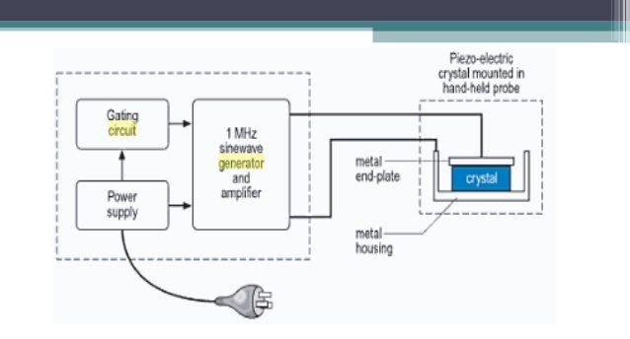

Slide 15
Many types of crystal can be used but the most favored are quartz, which occurs naturally, and some synthetic ceramic materials such as barium titanate and lead zirconate titanate (PZT).
These crystals deform when subjected to a varying potential difference – a piezo-electric effect.
In order to apply the electric charges, metal electrodes must be fixed to the crystal.
If a suitable metal plate is fixed to one surface of the crystal while the opposite surface is in air, then almost all the vibrational energy is transmitted from the crystal to the plate and hence to any solid or liquid to which it is applied.

Slide 16
Absorption of Sonic waves
Kinetic energy is converted to heat energy as it passes through the material.
The conversion of sonic energy to heat is due to increased molecular motion.

Slide 17
Attenuation of Ultrasound in the Tissues:
The loss of energy from the ultrasound beam in the tissues is called attenuation and depends on both absorption and scattering
Absorption accounts for some 60 – 80% of the energy lost from the beam. The scattered energy may also be absorbed other than in the region to which the ultrasound beam is applied.
Scattering is caused by reflections and refractions, which occur at interfaces throughout the tissues. This is particularly apparent where there is a large difference in acoustic impedance.

Slide 18
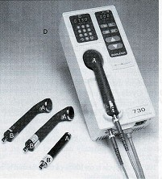
Transducer: ultrasound unit that contains the crystal
• Power: amount of acoustic energy per unit time (watts)
• Intensity: power per unit area of the ultrasound head (watts/cm²)

Slide 19
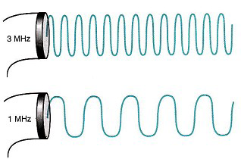
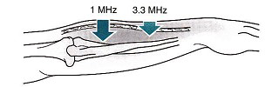
Frequency: number of Compression-rarefraction cycles per unit of time, usually expressed in cycles per second (Hertz)
• Increasing the frequency of US causes a decrease in its depth of penetration and concentration of the US energy in the superficial tissues.

Slide 20
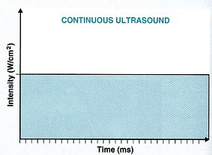
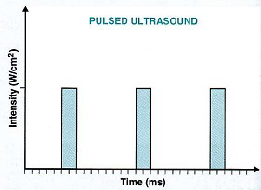
Types of ultrasound
Continuous ultrasound: continuous delivery of US through out the treatment period
• Pulsed ultrasound: delivering US only during a portion of the treatment period. Pulsing reduces the thermal effects

Slide 21
Coupling media
Ultrasound gel is a type of conductive medium that enables a tight bond between the skin and the transducer, letting the waves transmit directly to the tissues beneath and to the parts that need to be treated.
Ultrasound waves are not transmitted by air, thus some couplant which does transmit them must be interposed.
Unfortunately no couplant affords perfect transmission & only a percentage of the original intensity is transmitted to the patient.

Slide 22
Aquasonic gel 72.6%
Glycerol 67 %
Distal water 59 %
Petroleum jelly 0 %
Air 0 %

Slide 23
Physical & Physiological effects:
Thermal effects:
The advantage of using ultrasound to achieve heating is due to heating of collagen tissue and to the effective penetration of this energy to deeply placed structures.
Heating fibrous tissue structures such as joint capsules, ligaments, tendons, and scar tissue may cause a temporary increase in their extensibility, and hence a decrease in joint stiffness.

Slide 24
Mild heating can also have the effect of reducing pain and muscle spasm and promoting healing process.

Slide 25
Non thermal effects:-
Cavitation:
Cavitation is the formation of tiny gas bubbles in the tissues as a result of ultrasound vibration.
These can be of two types, namely stable cavitation or transient(non-stable) cavitation.
Stable cavitation occurs when the bubbles oscillate to and fro within the ultrasound pressure waves but remain intact.

Slide 26
Transient cavitation occurs when the volume of the bubble changes rapidly and then collapses causing high pressure and temperature changes, resulting in damage to tissues.
In practice the danger of tissue damage due to cavitation is minimized by the following measures:
Using space-averaged intensities below 4W/cm2
Using a pulsed source of ultrasound
Moving the transducer head during treatment.

Slide 27
Micromassage:-
The micromassage effect of ultrasound occurs at a cellular level where the cells are alternately compressed and then pulled further apart.
The waves of compression and rarefaction may produce a form of micromassage, which could reduce oedema.
Ultrasound has been found to be effective at reducing recent traumatic oedema and chronic indurated oedema.

Slide 28
Proliferative (Granulation) stage:-
This stage begins approximately 3 days after injury and is the stage at which the connective tissue framework is laid down by fibroblasts for the new blood vessels.
During repair, ultrasound can promote collagen synthesis by increasing cell membrane permeability, which allows the entry of calcium ions, which control cellular activity.

Slide 29
Remodelling Stage:-
This stage last months or years until the new tissue is as near in structure as possible to the original tissue.

Slide 30
Therapeutic Uses:-
Varicose Ulcers.
Pain relief.
Acute tissue injury.
Scar Tissue.
Bone injury.
Chronic Indurated Oedema.

Slide 31
Contraindications
Tumors.
Pregnant Uterus.
Epiphyseal plates.
Tuberculosis.
Radiotherapy.
Implants.

Slide 32
Dangers of Ultrasound:
Burns could occur if the heat generated exceeded the physiological ability to absorb it.
Tissue damage would result due to non-stable cavitation.
Blood cell stasis and endothelial damage may occur if there is standing wave formation.

