Slide 1
HYDROCOLLATROL PACK
By,
Dr.Pragati Patil
Assistant Professor
MPTH (Neurosciences)

Slide 2
Objectives
Introduction
Hydrocollateral pack
Method of application
Physiological effects
Indication
Contraindicatios
Advantages
disadvantages

Slide 3
Introduction
Hot packs are a way of transferring heat to the patient by conduction.
Commercial hot packs is one of the most common way to deliver superficial moist heat
The heating unit is called as hydrocollator unit .

Slide 4
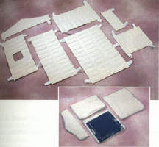
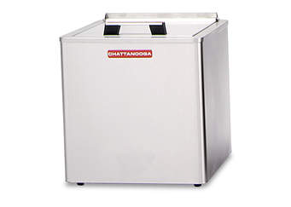
Hydrocollator unit

Slide 5
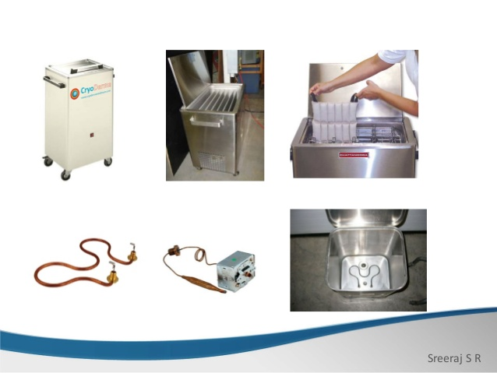

Slide 6
The hydrocollator Unit is a stainless steel tank in which silica gel packs or Bentonite crystal packs are heated.
The unit contain a wire rack which acts as divider for the packs and prevents contact of packs with the bottom of the tank.
These packs are stored in thermostatically controlled unit and maintains water in the unit at a temperature between 70°C and 80°C.

Slide 7
Hydrocollator Packs
Hydrocollator pack is a fabric envelop containing silica gel or bentonite crystal packs.
The main property of the gel or crystal is its:
    Capability to absorb many times its own volume of water,
    Provides a considerable store of heat energy .

Slide 8
These packs are heated in hydrocollator unit.
It gives moist heat for 20-30 min.
Packs are available in various sizes and shapes.
A special collar pattern pack for the neck is usually available.
The packs are wrapped in:
    Turkish towels -6-8 layers of toweling
The pack is applied to the body after being wrapped adequately in toweling .
This provides THERMAL INSULATION.

Slide 9
Method of application
Remove clothing and jewelry from the area to be treated and inspect the area.
Remove the pack from the unit and place it on the towel.
Fold another towel into 4-6 layers and place it over the pack.
Wrap the whole pack up with the bottom towel.
The temperature of the wrapped pack should not exceed the 42°C.

Slide 10
Monitor the initial response from the patient to treatment during the first 5-10 min.
Ask the patient for feedback and by visually inspecting the skin.
If necessary ,adjust the layer of the toweling.
During the treatment maintain the position of hot pack.

Slide 11
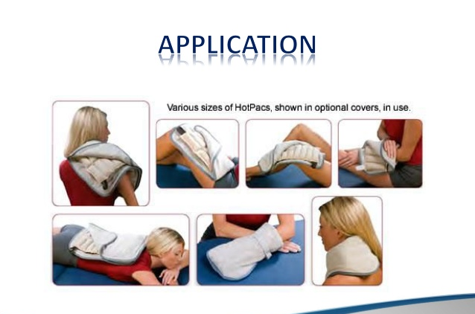

Slide 12
Physiological Effects of heat
Hemodynamic effect
Neuromuscular effect
Metabolic effect
Musculoskeletal effects –tissue extensibility

Slide 13
Hemodynamic effect
VASODILATION: heat causes vasodilation and thus increases rate of blood flow .
Heat causes liberation of histamine like substance which act on the capillaries and cause them to dilate
Heat regulatory center in the medulla also signals the capillaries to dilate as the temperature rises.
Increased transport of oxygen and nutrients removal of waste products.

Slide 14
Application of heat
Local rise in temperature
Vasodilatation
Increased transport of oxygen and nutrients
removal of waste products
Pain relief Therapeutic effect

Slide 15
Neuromuscular effect
Increases Nerve Conduction Velocity and firing rate .
Increasing tissue temperature has been shown to increase NCV .
Increasing PAIN THRESHOLD level.
Change in muscle strength

Slide 16
Heat stimulates the sensory nerves, perhaps the rise of temperature decrease gamma fiber activity ,
Decreases muscles spasm and promote relaxation
Decreases pain.

Slide 17
Metabolic rate
Increases metabolic rate .
Van’t Hoffs law: states that any chemical reaction capable of being accelerated is accelerated by rise in temperature.
( increasing temperature , increasing metabolic rate)

Slide 18
Musculoskeletal effect
Increases tissue extensibility .

Slide 19
Heat
Increased extensibility of collagen tissue.
Decreases joint stiffness therapeutic effect

Slide 20
Therapeutic effect
Relief of pain
Reduction of muscle spasm
Sedative effect
Increases range of motion
Increases local rise in temperature
Skin and connective tissue –skin become supple and elasticity of connective tissue also increased.
Accelerate healing –because increased blood circulation.

Slide 21
Indications
Muscle spasm
Joint stiffness
Rheumatoid arthritis
Osteoarthritis
Muscle stiffness
Chronic inflammation
Chronic edema
Adhesions

Slide 22
Contraindications
Open wound
Allergic rash
Skin condition
Recent hemorrhage
Impaired skin sensation
Skin condition

Slide 23
Advantages
Easy to apply
Available in various size and shape which fit most clinical need.
Low cost minimal maintenance
Low level of skill needed for application .
Safe …
Inexpensive material –packs and towels

Slide 24
Disadvantage
Hot moist pack must be moved to observe the treatment area during treatment.
Patient may not tolerate the weight of hot pack
Sometimes moist packs have a tendency to cause a skin rash..
Active motion not practical during treatment .
Expensive equipment.

Slide 25
Dangers And Precaution
Burn may occur due to-
      Insufficient toweling
      The temperature of the pack could be too high
Dehydration –because of excessive sweating .

Slide 26
Questions
Contents of hot moist pack?
Method of application?
Indications ,contraindications?
Physiological effects
Therapeutic effects

