Slide 1
RUSSIAN CURRENTS
DR.POONAM PATIL

Slide 2
INTRODUCTION
Medium frequency current
Intermittent alternating sinusoidal current
Sinusoidal waveform, delivered in series of pulses

Slide 3
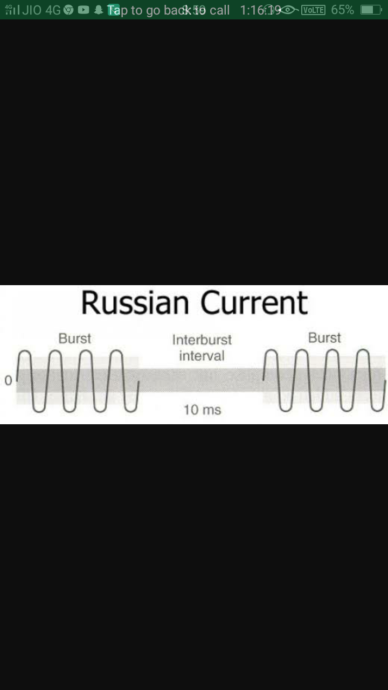

Slide 4
Characteristics
Frequency-2 500hz
Waveform- Polyphasic sinusoidal waveform
Current Amplitude- The maximum current amplitude is 100mA
Clinical used -70mA

Slide 5
CONTINUED…
Pulse Duration - 10ms
On\Off Ratio- It is defined as the ratio of time during which there is stimulation to the time during which there is no stimulation.
Set as 10:10 ms

Slide 6
continued
Duty cycle- It is the proportion of ON time to summation of both the ON and the OFF time expressed as percentages.
For eg : 10:10ms sets up a duty cycle of=10/10+10x 100=50%
Ramp-up and Down –Setting ramp time is very important for muscle contraction. As ramp allows gradual increase of intensity with associated gradual increase of muscle contraction. Set for 1-2 secs.

Slide 7
Continued……
Duration- 10mins i.e. to give once per week(3-6months)
Electrode Placement- Arrange parallel to direction of muscle fibres.

Slide 8
PHYSIOLOGICAL EFFECTS
Medium frequency sinusoidal current
Depolarization of sensory and motor nerve fibres
Prickling Tetanic muscle
sensation contraction
Activation of fast type II motor units
D

Slide 9
Muscular contraction
Contraction against external load
Muscle strengthening

Slide 10
INDICATIONS
To increase muscular strength of athletic patients
To reduce muscle spasm
To reduce oedema
To reduce pain

Slide 11
CONTRAINDICATIONS
  Do not apply over
  Lower back during pregnancy
  Metal implant area
  Mentally retarded patients
  Venous thrombosis

Slide 12
THANK
YOU!!!!

