Slide 1
CHEST MOBILITY EXERCISES
Dr.Poonam Patil

Slide 2
Q. WHAT ARE CHEST MOBILITY EXERCISES?
ANSWER.
-Chest mobilization exercises are any exercises that combine active movements of the trunk or extremities with deep breathing.
- They are designed to maintain or improve mobility of the chest wall, trunk, and shoulder girdles when it affects ventilation or postural alignment.

Slide 3
-For example, a patient with hypomobility of the trunk muscles on one side of the body does not expand that part of the chest fully during inspiration.
-Exercise that combine stretching of these muscles with deep breathing improve ventilation on that side of the chest.

Slide 4
-Chest mobilization exercises also are used to reinforce or emphasize the depth of inspiration or controlled expiration.
- A patient can reinforce expiration, for example, by leaning forward at the hips or flexing the spine as he or she breathes out..

Slide 5
SPECIFIC TECHNIQUES
TO MOBILIZE ONE SIDE OF THE CHEST
-While sitting, the patient bend away from the tight side to lengthen hypomobile structures and expand that side of the chest during inspiration.
-Then, have the patient push the fisted hand into the lateral aspect of the chest, bend toward the tight side, an breathe out.

Slide 6
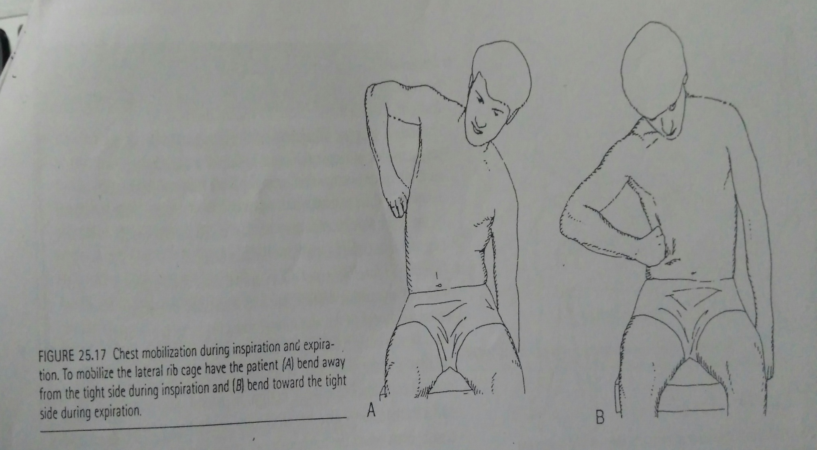

Slide 7
TO MOBLIZE THE UPPER CHEST AND STRETCH THE PECTORALIS MUSCLES.
- While the patient is sitting in a chair with hands clasped behind the head, have him or her horizontally abduct the arms (elongating the pectoralis major) during a deep inspiration.
-Then instruct the patient to bring the elbows together and bend forward during expiration.

Slide 8
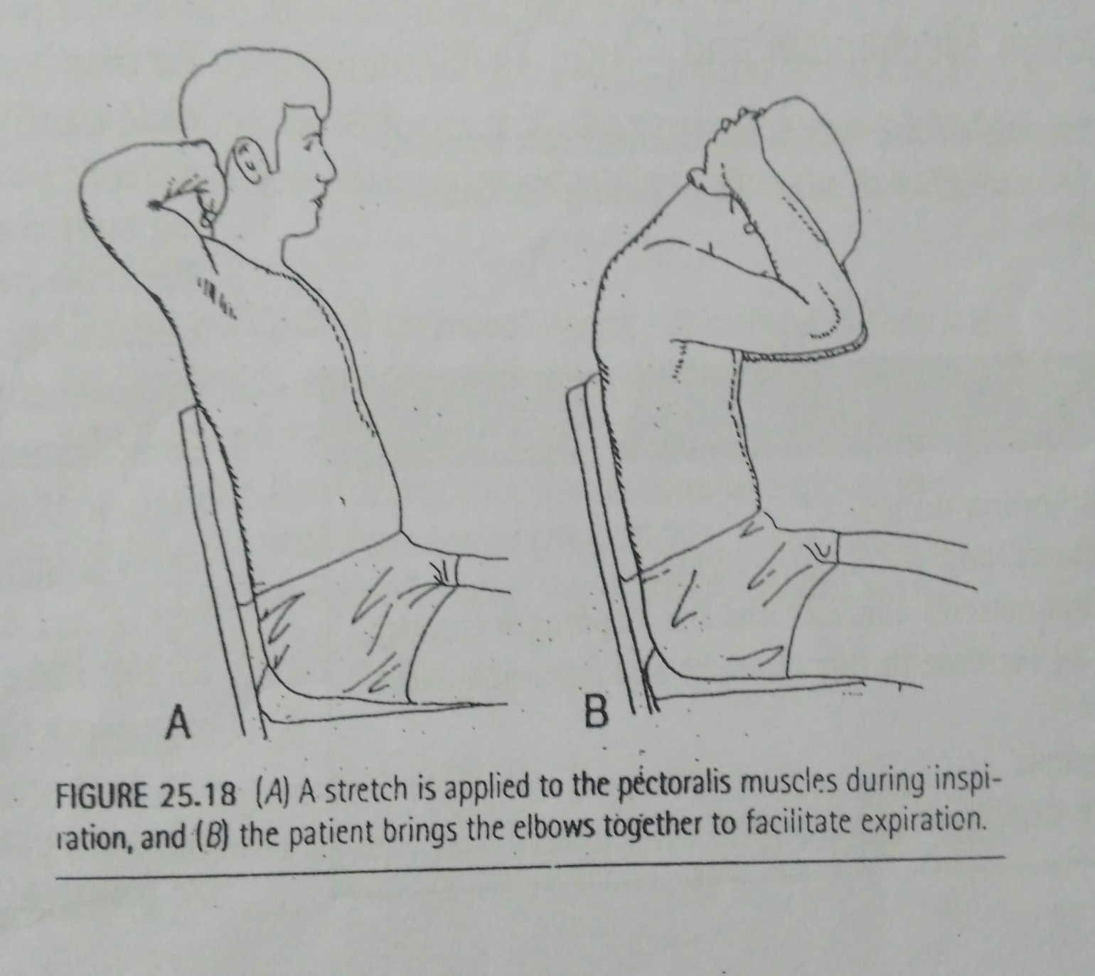

Slide 9
TO MOBILIZE THE UPPER CHEST AND SHOULDERS
While sitting in a chair, have the patient reach with both arms overhead(180 degrees bilateral shoulder flexion and slight abduction) during inspiration and then bend forward at the hips and reach for the floor during expiration.

Slide 10
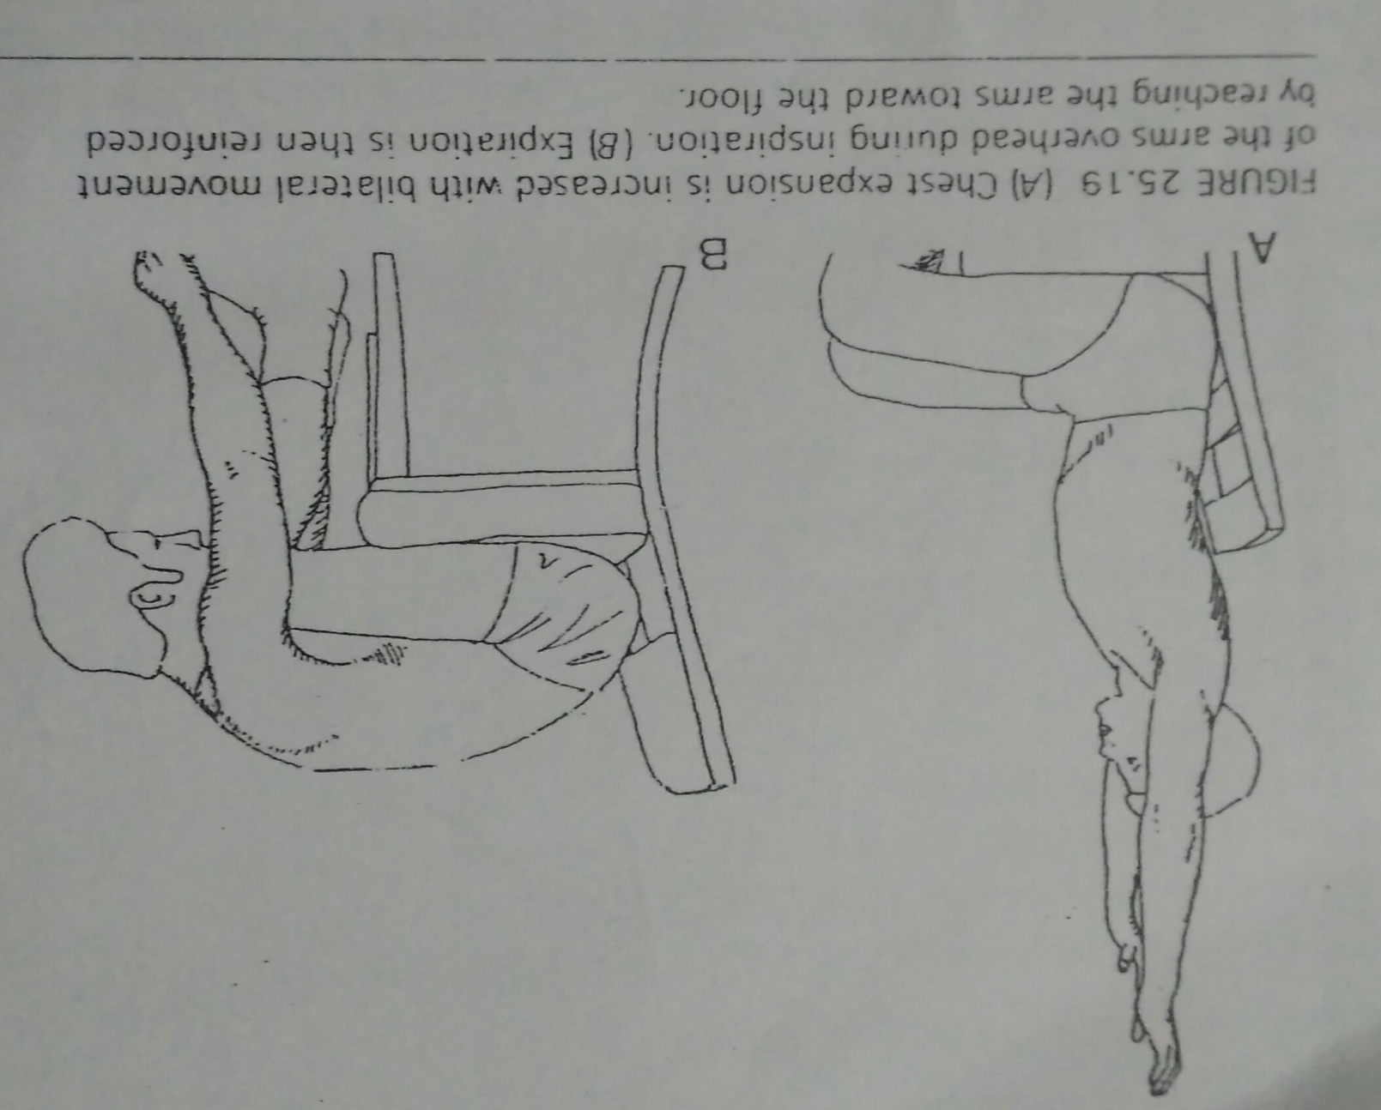

Slide 11
THANK YOU

